Slide 1

Nida and ‘the Science of Translating’
Eugene A. Nida (1914–2011)
Speakers: 蒋彬彬 20261210021
夏雨 20261210018
In Pursuit of Excellence in Interpreting and Translation
译无止境，臻于至善
In Pursuit of Excellence in Interpreting and Translation
译无止境，臻于至善

Slide 2
01
Introduction
content
02
The Influence of Chomsky
03
The Nature of Meaning
04
Formal vs Dynamic Equivalence
05
Critical Reception & Legacy
In Pursuit of Excellence in Interpreting and Translation
译无止境，臻于至善
In Pursuit of Excellence in Interpreting and Translation
译无止境，臻于至善

Slide 3
01
Introduction
In Pursuit of Excellence in Interpreting and Translation
译无止境，臻于至善
In Pursuit of Excellence in Interpreting and Translation
译无止境，臻于至善

Slide 4
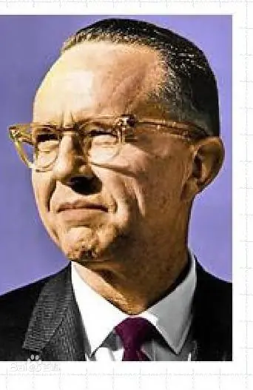
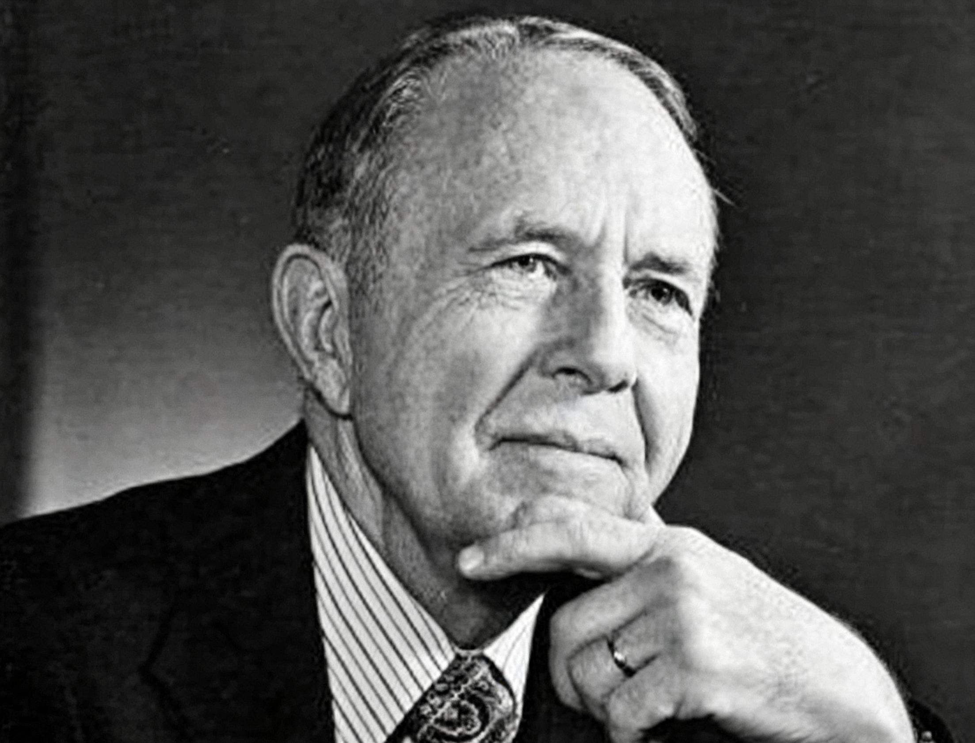
Introduction
Eugene A. Nida (1914-2011) was a leading American linguist and translation theorist, widely hailed as the founding father of modern translations science. He developed his approach through practical Bible translation work from the 1940s onward.
In Pursuit of Excellence in Interpreting and Translation
译无止境，臻于至善

Slide 5
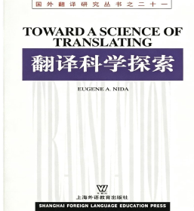
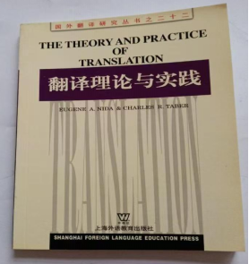
Major Works
1.Toward a Science of Translating (1964): Nida attempts to move Bible translation into a more scientific era by incorporating recent work in linguistics.
2.The Theory and Practice of Translation (Nida & Taber, 1969): Nida gives a clear definition of dynamic equivalence.
In Pursuit of Excellence in Interpreting and Translation
译无止境，臻于至善

Slide 6
Why is it called “ the science of translating”?
Nida sought a systematic and analytical approach to translation.
He drew on linguistics, semantics, pragmatics and syntax.
Translation could be analysed through identifiable procedures.
The translator’s task involves analysis, transfer and restructuring.
In Pursuit of Excellence in Interpreting and Translation
译无止境，臻于至善
In Pursuit of Excellence in Interpreting and Translation
译无止境，臻于至善

Slide 7
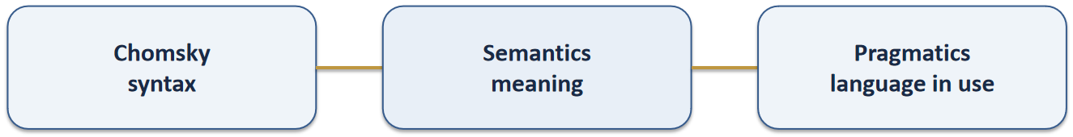
The Linguistic Foundations
Nida incorporates insights from:
• Semantics — meaning
• Pragmatics — meaning in context
• Chomsky’s syntactic model
• Generative-transformational grammar
These provide tools for analysing and reformulating messages
In Pursuit of Excellence in Interpreting and Translation
译无止境，臻于至善
In Pursuit of Excellence in Interpreting and Translation
译无止境，臻于至善

Slide 8
02
The influence of Chomsky
In Pursuit of Excellence in Interpreting and Translation
译无止境，臻于至善
In Pursuit of Excellence in Interpreting and Translation
译无止境，臻于至善

Slide 9
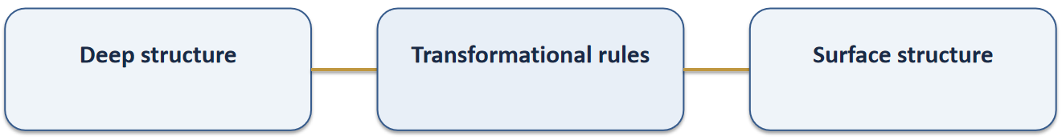
Chomsky’s Generative-transforational model
Phrase-structure rules → deep / underlying structure
Transformational rules → surface structure
Phonological and morphemic rules → linguistic realization
In Pursuit of Excellence in Interpreting and Translation
译无止境，臻于至善

Slide 10
eg.
deep structure: Police-Arrest-Criminal 施事者-动作-受事者
↓
surface structure: The police arrested the criminal./
The criminal was arrested by the police.
What is kernel？
Kernels are simple, active, declarative sentences, requiring minimal transformation.
Kernels are the basic structural elements from which language constructs complex surface structures.
Different languages share more commonality at the kernel level than at the level of complex surface structures (word order).
Back Transformation: reducing complex structures to kernels
In Pursuit of Excellence in Interpreting and Translation
译无止境，臻于至善
In Pursuit of Excellence in Interpreting and Translation
译无止境，臻于至善

Slide 11
Four types of functional class
(1) EVENTS: often but not always performed by verbs (e.g., run,fall,grow, think);
(2) OBJECTS: often but not always performed by nouns (e.g., man, horse, mountain);
(3) ABSTRACTS: quantities and qualities, including adjectives and adverbs (e.g., red,
length, slowly);
(4) RELATIONALS: including affixes, prepositions, conjunctions and copulas (e.g., pre-,
into, of, and, because, be).
These categories help translators break down complex surface structures.
In Pursuit of Excellence in Interpreting and Translation
译无止境，臻于至善

Slide 12
Example1: “Will of God”
Surface expression: “will of God”
Underlying relationship: B (OBJECT, God) performs A (EVENT, wills)
Kernel: God wills
Example2: “Creation of the World”
Surface expression: “creation of the world”
Underlying relationship: B (OBJECT, the world) is performed by A (EVENT, creates)
Kernel: The world is created by A
Surface form is not directly equal to deep meaning relation.
In Pursuit of Excellence in Interpreting and Translation
译无止境，臻于至善
In Pursuit of Excellence in Interpreting and Translation
译无止境，臻于至善

Slide 13
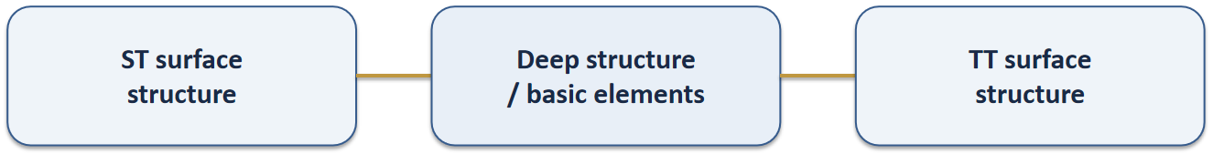
Nida’s three-stage system of translation
1. ANALYSIS
Identify linguistic and semantic relationships in the source text
2. TRANSFER
Transfer the analysed message from SL to TL
3. RESTRUCTURING
Re-express the message naturally in the receptor language
In Pursuit of Excellence in Interpreting and Translation
译无止境，臻于至善

Slide 14
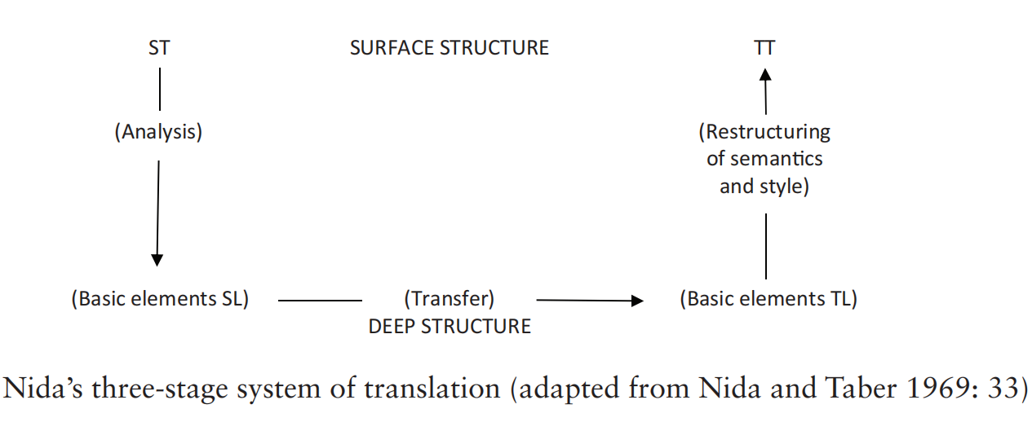
In Pursuit of Excellence in Interpreting and Translation
译无止境，臻于至善
In Pursuit of Excellence in Interpreting and Translation
译无止境，臻于至善

Slide 15
eg.
The boy opened the door.
↓
Analysis
BOY + OPEN + DOOR （Agent+Action+Object）
↓
Transfer
男孩 + 打开 + 门（主语+动词+宾语）
↓
Restructuring
男孩打开了门。/门被男孩打开了。
In Pursuit of Excellence in Interpreting and Translation
译无止境，臻于至善
In Pursuit of Excellence in Interpreting and Translation
译无止境，臻于至善

Slide 16
03
The Nature of Meaning:
advances in semantics and pragmatics
In Pursuit of Excellence in Interpreting and Translation
译无止境，臻于至善
In Pursuit of Excellence in Interpreting and Translation
译无止境，臻于至善

Slide 17
What Is “Meaning”?
Nida opposed understanding word meaning as completely fixed “dictionary units.”
Meaning has a functional character: words have specific meaning in context.
The same word may produce different associations / responses in different cultures.
Three Types of Meaning:
1. LINGUISTIC MEANING
the relationship between different linguistic structures (his house, his journey, his kindness)
2.REFERENTIAL MEANING
denotative “ dictionary” meaning (son = male child)
3. EMOTIVE MEANING
Associations or connotations a word produces (Don’t worry about that, son.)
In Pursuit of Excellence in Interpreting and Translation
译无止境，臻于至善

Slide 18
Analysing Semantic Structure
Nida proposes systematic techniques such as:
hierarchical structuring:
differentiating series of words according to their level
eg. the superordinate animal and its hyponyms goat, dog, cow etc.
componential analysis:
seeking to identify and discriminate specific features of a range of related words. (kinship terms）
semantic structure analysis:
encouraging the trainee translator to realize that the sense of a complex semantic term;
stressing the importance of context for communication when dealing with metaphorical meaning and with complex cultural idioms. （spirit)
These techniques help translators identify the relevent features of meaning before reformulation
In Pursuit of Excellence in Interpreting and Translation
译无止境，臻于至善
In Pursuit of Excellence in Interpreting and Translation
译无止境，臻于至善

Slide 19
04
Formal vs Dynamic Equivalence
In Pursuit of Excellence in Interpreting and Translation
译无止境，臻于至善
In Pursuit of Excellence in Interpreting and Translation
译无止境，臻于至善

Slide 20
Since no two language are identical, either in the meanings given to corresponding symbols or in the ways in which such symbols are arranged in phrases and sentences, it stands to reason that there can be no absolute correspondence between languages.
-------Eugene Nida
In Pursuit of Excellence in Interpreting and Translation
译无止境，臻于至善
In Pursuit of Excellence in Interpreting and Translation
译无止境，臻于至善
Notes:
Hence there can be no fully exact translations. The total impact of a translation may be reasonably close to the original, but there can be no identity in detail.s

Slide 21
Formal Equivalence
It focuses attention on the message itself, in both form and content. The receptor language message should match as closely as possible the different elements in the source language.
It might be called a "gloss translation" which the transaltor attempts to reproduce as literally and meaningfully as possible the form and content of the original.
explain the formal features which could not be adequately represented
Medieval French text-English
for
students of early French literature
footnotes
make intelligible some of the formal equivalents employed
In Pursuit of Excellence in Interpreting and Translation
译无止境，臻于至善

Slide 22
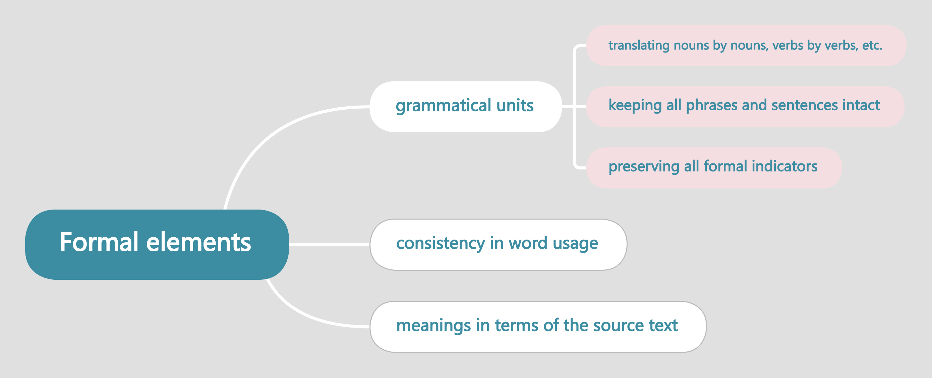
F-E translation attempts to reproduce……
In Pursuit of Excellence in Interpreting and Translation
译无止境，臻于至善

Slide 23
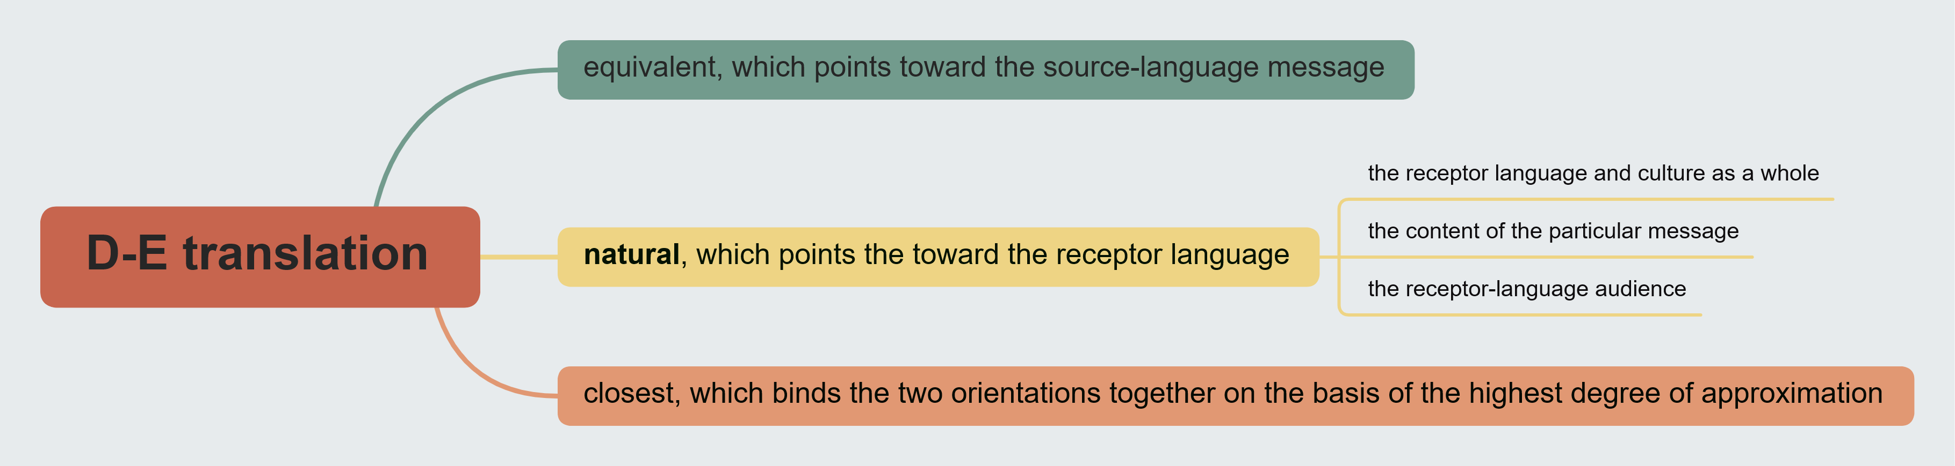
Dynamic Equivalence
Based on "the principle of equivalent effect"(Rieu and Phillips,1954), where the relationship between receptor and message should be substantially the same as that which existed between the original receptors and the message.
It aims at complete naturalness of expression, and tries to relate the receptor to modes of behavior relevant within the context of his own culture
In Pursuit of Excellence in Interpreting and Translation
译无止境，臻于至善

Slide 24
Tytler？
How to achieve dynamic equivalence?
How to achieve equivalent response?
1. making sense;
2. conveying the spirit and manner of the original;
3. having a natural and easy form of expression;
4. producing a similar response.
four basic requirements of a translation
In Pursuit of Excellence in Interpreting and Translation
译无止境，臻于至善

Slide 25
The translation should give a complete transcript of the ideas of the original work
Tytler's three general rules
The style and manner of writing should be of the same character with that of the original
The translation should have all the ease of the original composition
In Pursuit of Excellence in Interpreting and Translation
译无止境，臻于至善

Slide 26
 | Formal Equivalence | Dynamic Equivalence
Definition | word for word | convey the thought expressed in a source text
Principle | focuses on the original text and expresses the form and content of the original text | aims at complete naturalness of expression
Requirement | the message in the receptor language should match as closely as possible as the different elements in the source language | the relationship between receptor and message should be substentially the same as that which existed between the original receptors and the message
Example | "It's raining cats and dogs"直译为"下着猫和狗" | "It's raining cats and dogs"译为"下着倾盆大雨"
Strengths | preserves the linguistic and cultural features of the original | 1. Produces a natural, fluent text that conforms to target-language conventions; 2. lowers comprehension barriers and enables effective cross-cultural communication.
Limitations | awkward and may cause comprehension difficulties for readers | 1. lose cultural and stylistic features of the original; 2. Judgments of "equivalent response" are inherently subjective.
Preferred Text Types | legal documents、academic papers、religious scriptures | literary works、 audiovisual translation、advertising
"圣吻"(footnotes: an ancient Mediterranean greeting ritual for believers, representing sincere Chistian fellowship, not romantic affection.)
"greet one another with a holy kiss"
----Romans
"give one another a hearty handshake all around"
formal
dynamic

Slide 27

Dynamic Equivalence in Action
Case Study: The Holy Kiss
In Romans 16:16, the Greek original instructs readers to greet one another with a holy kiss. This cultural practice was common in the early Christian church but unfamiliar in many modern cultures.
J.B. Phillips dynamic equivalent translation renders this as give one another a hearty handshake all around. This adaptation preserves the original meaning while using a culturally appropriate expression. The form changes but the effect remains equivalent.
In Pursuit of Excellence in Interpreting and Translation
译无止境，臻于至善

Slide 28
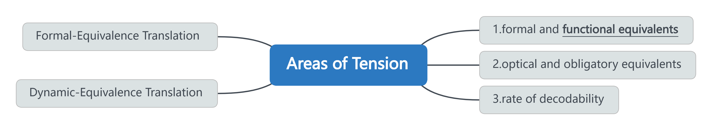
Functional Equivalence (1993)
1. There may be no object or event in the receptor culture which corresponds to some referent in the source text, but the equivalent function is realized by another object or event……
2. The obligatory categories of various languages give them their distinctive character, and at the same time impose serious restrictions on the extent to which corresponding expressions can be made fully equivalent……
3. One must consider the rate at which the message is both transmitted and decoded……
In Pursuit of Excellence in Interpreting and Translation
译无止境，臻于至善
In Pursuit of Excellence in Interpreting and Translation
译无止境，臻于至善

Slide 29
Anything less than this degree of equivalence should be unacceptable.
The term"dynamic"has been misunderstood by some persons as referring only to something which has impact.
Dynamic Equivalence
A minimal: The readers of a translated text should be able to comprehend it to the point that they can conceive of how the original readers of the text must have understood and appreciated it.
Functional Equivalence
A maximal: The readers of a translated text should be able to understand and appreciate it in essentially the same manner as the original readers did.
rarely achieved, except for texts having little or no aesthetic value and involving only routine information
In Pursuit of Excellence in Interpreting and Translation
译无止境，臻于至善
In Pursuit of Excellence in Interpreting and Translation
译无止境，臻于至善

Slide 30
05
Critical Reception & Legacy
In Pursuit of Excellence in Interpreting and Translation
译无止境，臻于至善
In Pursuit of Excellence in Interpreting and Translation
译无止境，臻于至善

Slide 31
Critical Reception: Implausibility＆Theological and Proselytizing Standpoint
1
Lefevere (1993)
2
Edwin Gentzler
Andre Lefevere feels equivalence is still overly concerned with the word level, arguing Nida approach does not account for broader cultural and ideological forces shaping translation.
Gentzler (1993), from a deconstructionist perspective, denigrates Nida work for its theological standpoint. He argues dynamic equivalence serves converting receptors to Protestant Christianity.
3
van den Broeck and Larose
4
Qian Hu (1993)
Van den Broeck (1978) and Larose (1989) consider equivalent effect impossible. They ask: how is the effect measured and on whom? How can a text have the same effect in two cultures?
Qian Hu published papers in Meta (1992-1993) demonstrating the implausibility of equivalent response, focusing on the impossibility when meaning is bound up in form, especially in literary works.
In Pursuit of Excellence in Interpreting and Translation
译无止境，臻于至善

Slide 32
Newmark stated dynamic equivalence is an important concept which has a degree of application to any type of text, but not the same degree of importance. He saw it as broadly applicable across text types.
Peter Newmark
Divided Opinions: The core question is whether a theory developed primarily for Bible translation can be extended to all text types, or whether it is limited to certain kinds of communicative texts where equivalent effect is the primary goal.
VS
Gentzler expressed doubts about applying dynamic equivalence to general translation practice, especially literary translation. In his view, Nida theory is only useful for propaganda, advertisement or certain religious material.
Edwin Gentzler
In Pursuit of Excellence in Interpreting and Translation
译无止境，臻于至善

Slide 33
Nida's Defense and Enduring Legacy
Nida's Stance: Acknowledged that "artistic sensibility" is essential for literary translation; DE is a dynamic concept, not an absolute state.
Monumental Contributions: Formulated a systematic analytical procedure for translators; brought the receptor's cultural expectations into translation equation.
Influence: Profundly shaped later scholars, notable Peter Newmark and Werner Koller.
In Pursuit of Excellence in Interpreting and Translation
译无止境，臻于至善

Slide 34
Beyond Literal vs Free
Nida theory avoids the traditional debate of literal versus free translation, providing a new perspective. He introduced a scientific, linguistic approach that transcended the old binary opposition.
Reader-Oriented Approach
Nida freed translators from source text structural constraints by shifting focus from strict correspondence to the receptor response. This receptor-oriented approach revolutionized translation theory.
Scientific Methodology
Nida produced a systematic analytical procedure for translators working with all kinds of texts. He factored target text receivers and their cultural expectations into the translation equation.
In Pursuit of Excellence in Interpreting and Translation
译无止境，臻于至善

Slide 35
Conclusion
"Translation is not merely an art, but a science that can and must be described and regulated by objective principles."
"Translation activity should never be carried out arbitrarily."
It is well to remember that Nida's work is aimed above all at training translators who do not have expertise in linguistics but who have to deal with very different cultures. It may, therefore, be helpful now to attempt to adopt his model not for the analysis of existing translations but for the analysis of an ST that is to be translated.
In Pursuit of Excellence in Interpreting and Translation
译无止境，臻于至善
In Pursuit of Excellence in Interpreting and Translation
译无止境，臻于至善

Slide 36
Thank You
In Pursuit of Excellence in Interpreting and Translation
译无止境，臻于至善
In Pursuit of Excellence in Interpreting and Translation
译无止境，臻于至善

